Slide 1

From Feedback to Insight:Understanding
Reviews
through Text
Sofia Caceres
Notes:
sofia

Slide 2
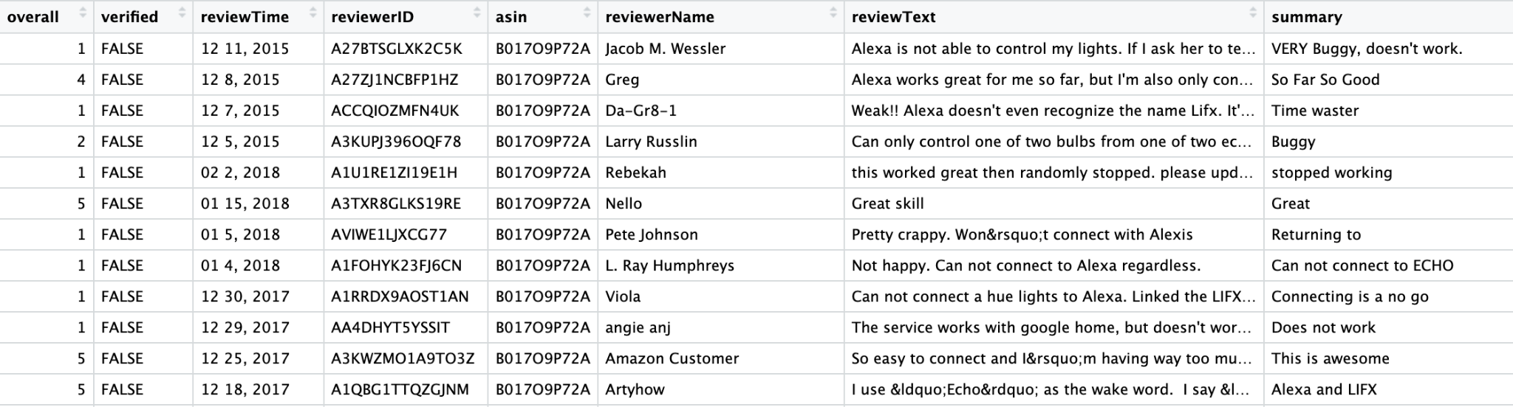
Our Dataset:
Real-world Amazon customer data
6.4 million reviews
Star ratings + review text
(https://www.kaggle.com/datasets/sahityasahu/amazon-review-dataset/data
Notes:
sofia

Slide 3

Summary: Call a Taxi
Overall:
Review: Zero stars. Don't work. I request a ride all kind of ways and it put my request to my shopping list. What a joke. Called a cab
-Glenn Smith
Summary:Garbage
Overall:
Review: You'd think Amazon would do a little research on how horrible AccuWeather is but clearsell outs happen every day.
-Amazon Customer
Notes:
sofia

Slide 4
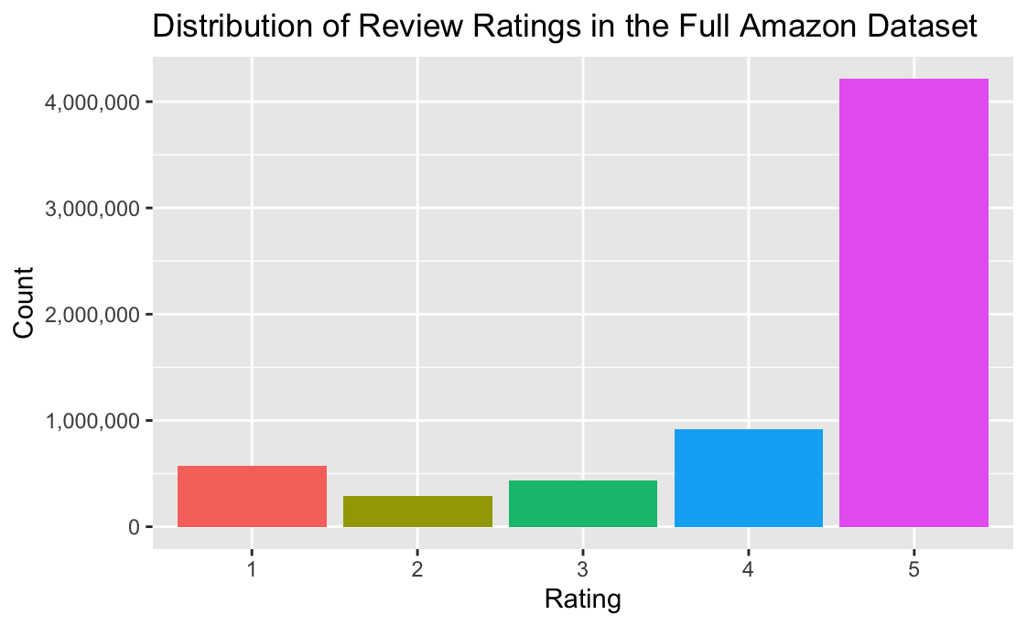
Notes:
sofia

Slide 5
Target Audience:
Business and product teams looking to improve their products based on customer reviews and identify what customers love most to guide marketing strategies

Slide 6
Research Question:
What words and language patterns are most associated with low-rated versus high-rated Amazon reviews?

Slide 7
CHTC
Word Counts
Input
Output
6.4 million reviews
(36.85 GB)
26 parallel jobs
~250,000 reviews each
Word Count csv
500,000 rows

Slide 8
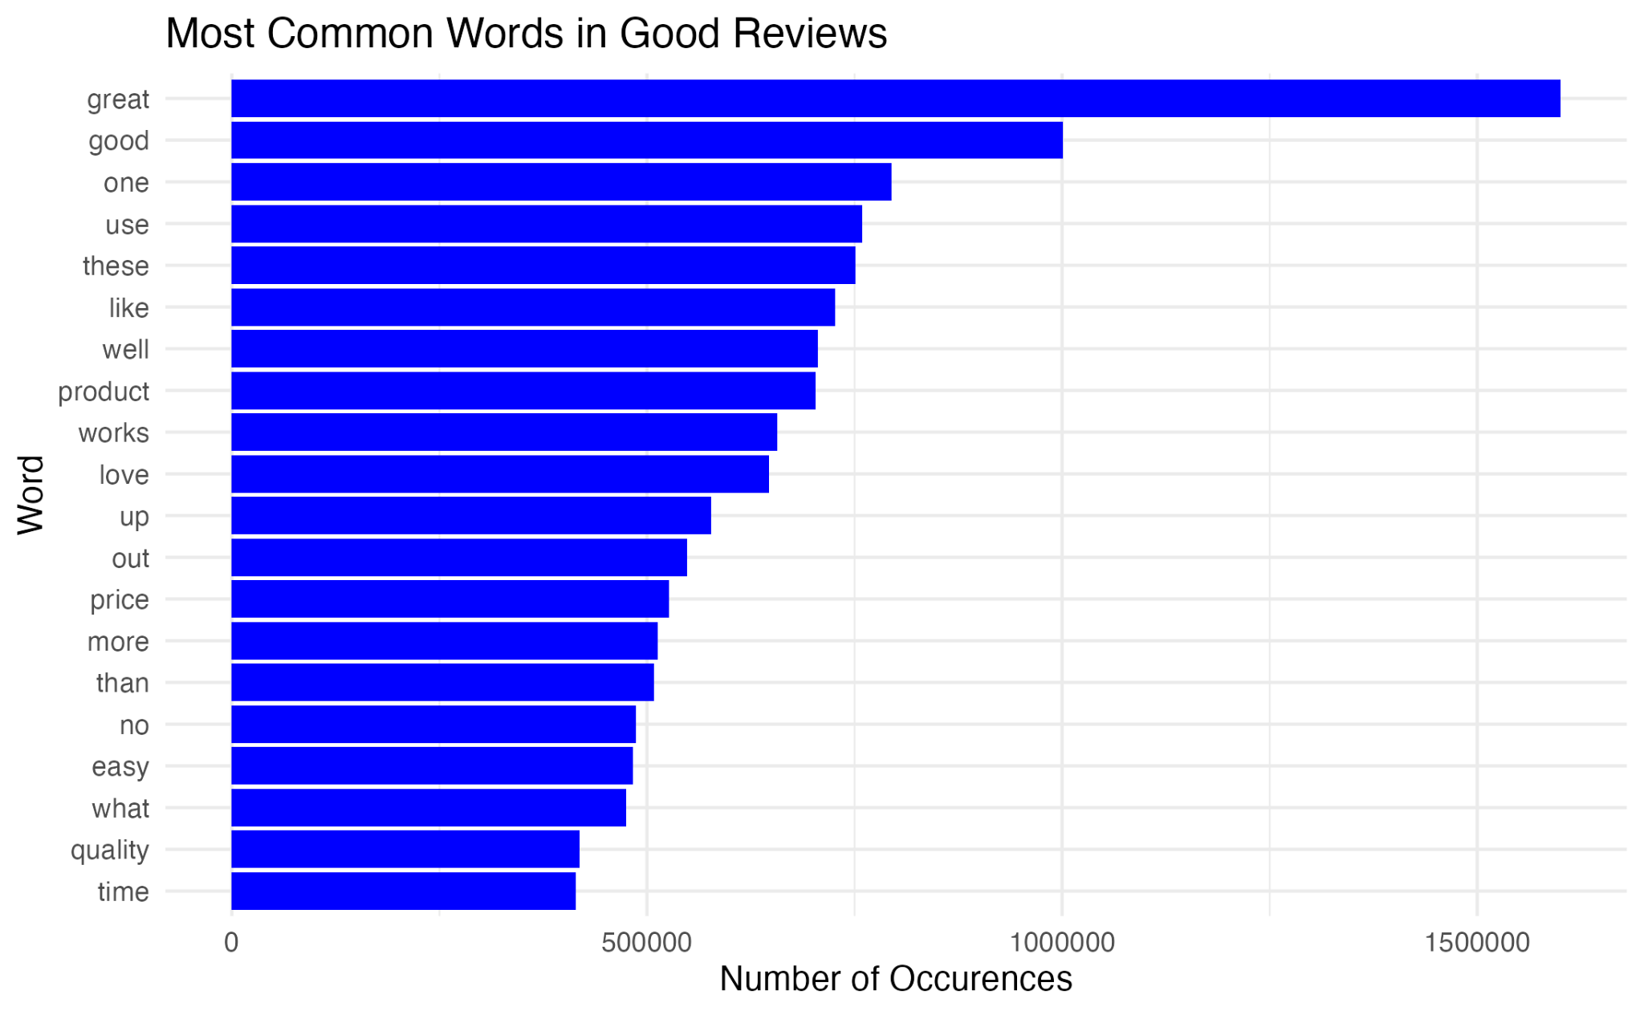
Word Counts

Slide 9
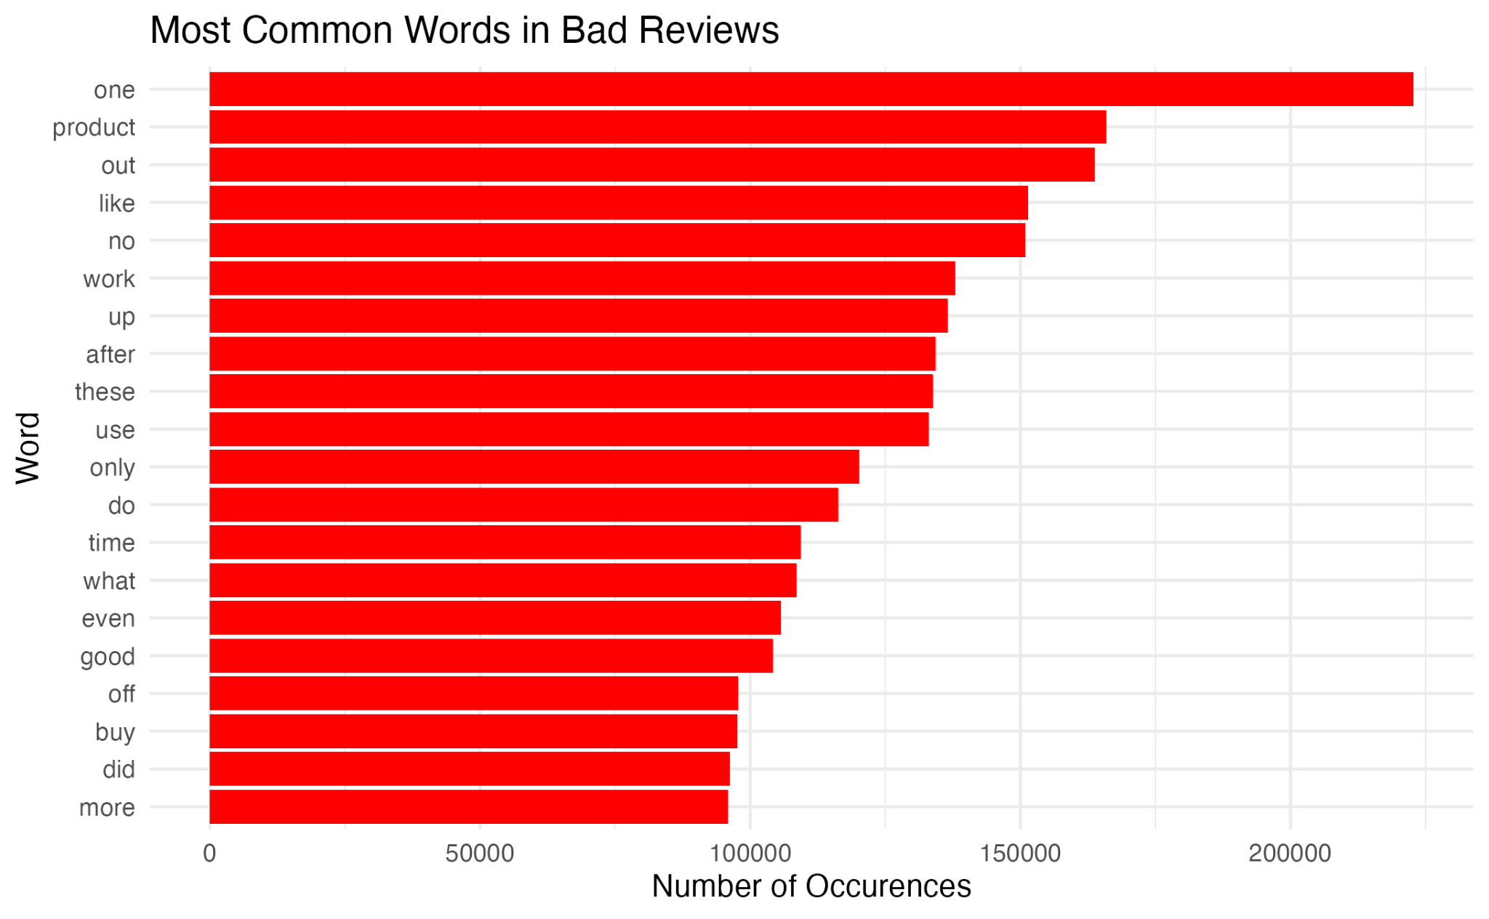
Word Counts

Slide 10
Data Cleaning
Extracted reviewText field from the Amazon review JSON data
FIltered reviews into two groups:
Low rated: 1-2 stars
High rated: 4-5 stars
Removed 3-star reviews (neutral)
Removed punctuation and tokenized text into individual words
Removed blank entries
Removed common words such as “the”, “and”, “is”, and “to”
Computed word frequencies for low and high rated reviews separately

Slide 11
Our Models
Logistic Regression
Random Forest
X = Binary Word indicators from the top 100 most common words
y = High-Rated, Low-Rated

Slide 12
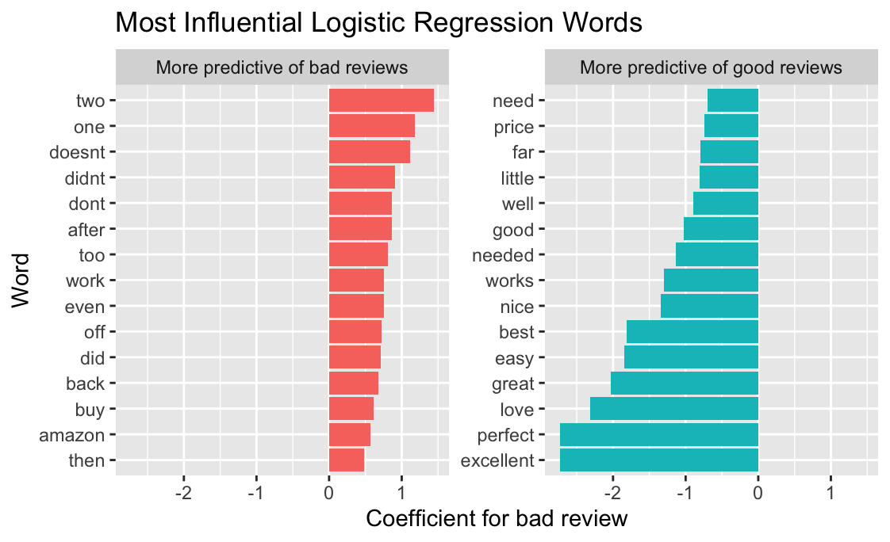
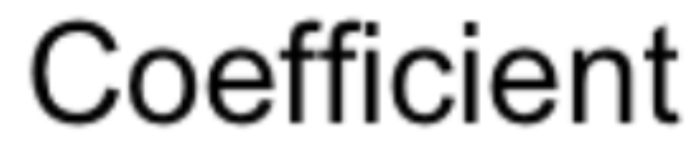
Logistic Regression

Slide 13
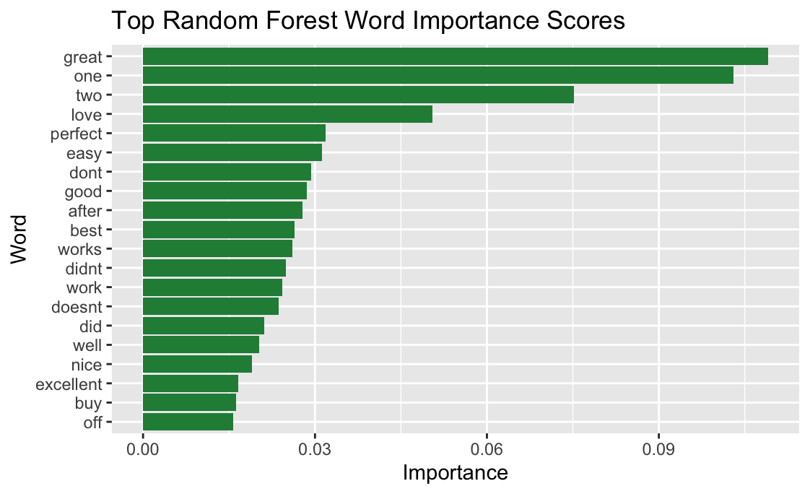
Random Forest

Slide 14
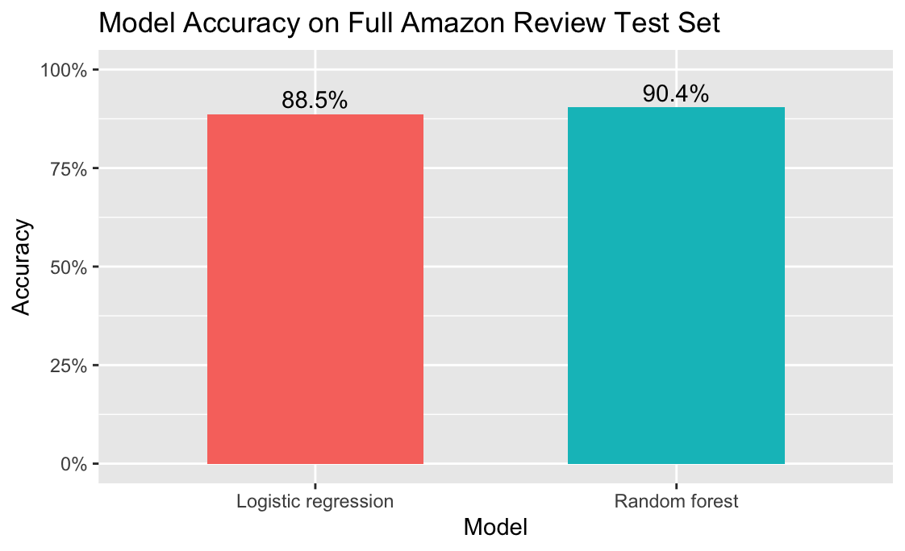
Accuracy

Slide 15
High-rated reviews had clear and consistent language patterns, with terms like “excellent”, “perfect”, and “love” strongly tied to positive customer experiences
Negative Reviews commonly mention malfunctions (doesn’t, work, off)
Results and Conlusions

Slide 16
Challenges
The dataset was imbalanced with more high-rated reviews than low-rated reviews
The model uses individual words, so they lost phrases like “doesn’t work” or “don’t buy”
Some words were hard to interpret because the model could not tell how they were being used in a sentence.

Slide 17
Future Considerations
Using two word phrases to capture clearer patterns
Better measure of customer opinion
Use a more balanced dataset

Slide 18
Thank you for listening!

